Slide 1
The JET Library
Susan Bloom, MLIS, MS
Associate Librarian, Head of Instruction and Outreach

Slide 2
Sections
JET Homepage
Faculty Resources
Faculty Resources Guide
Help

Slide 4
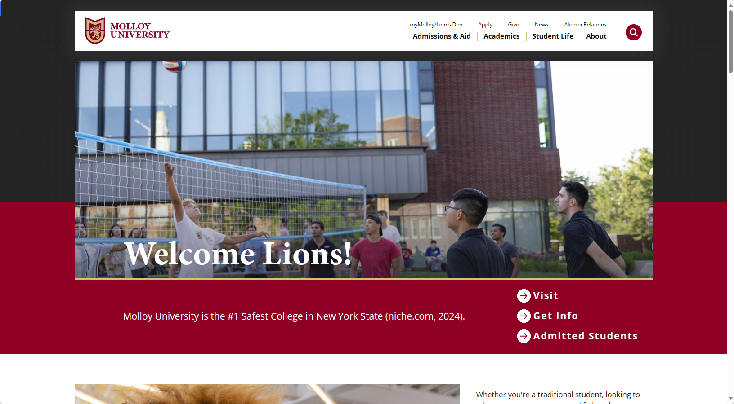

Slide 5
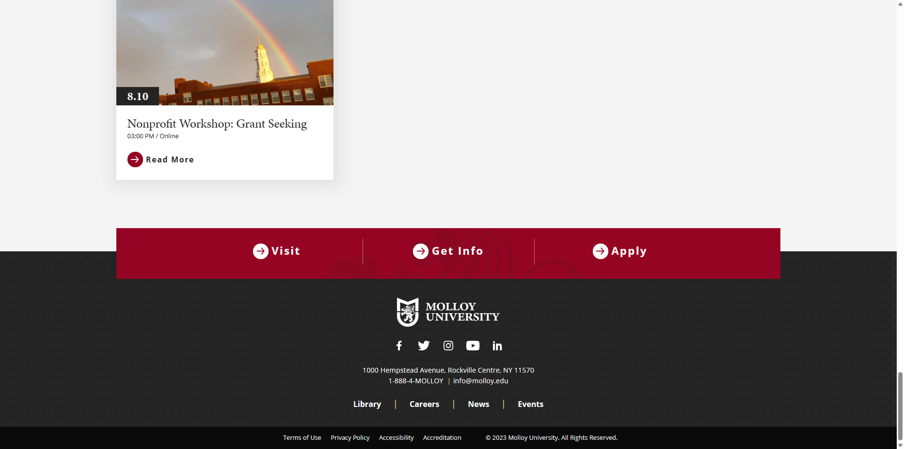

Slide 6
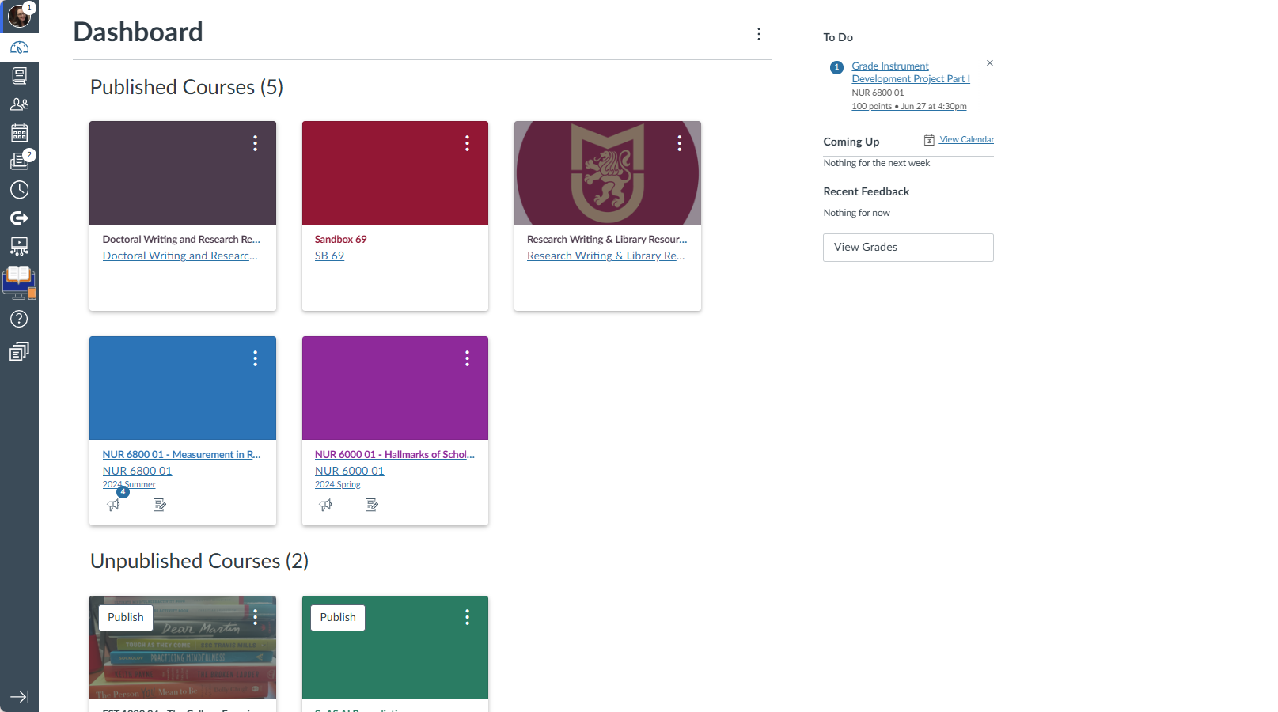

Slide 7
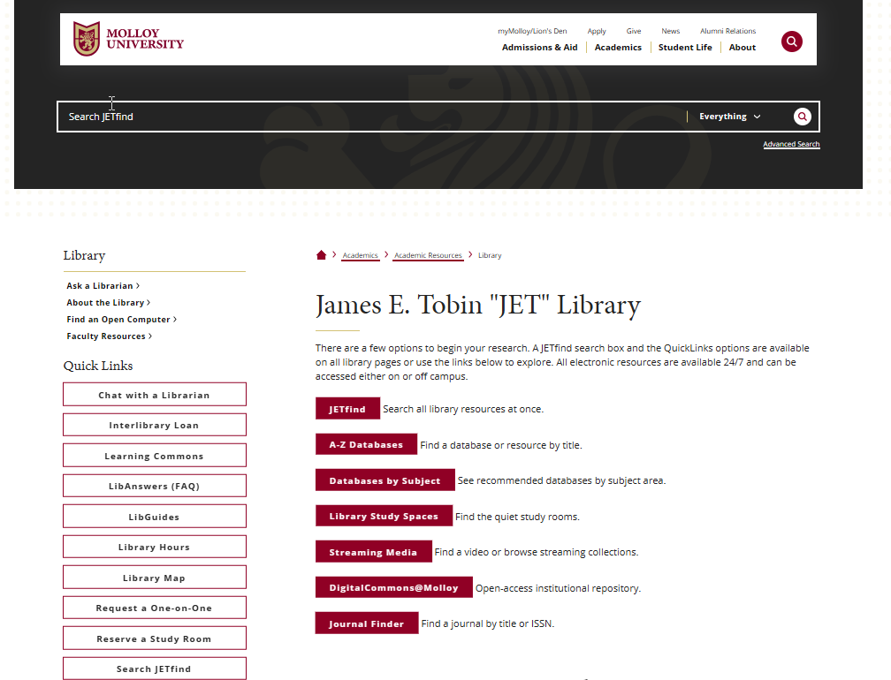

Slide 8
Faculty Resources

Slide 9
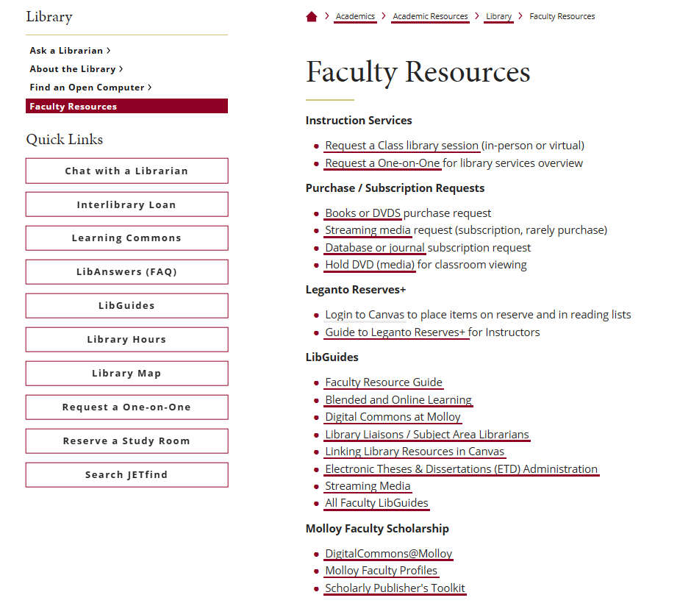

Slide 10
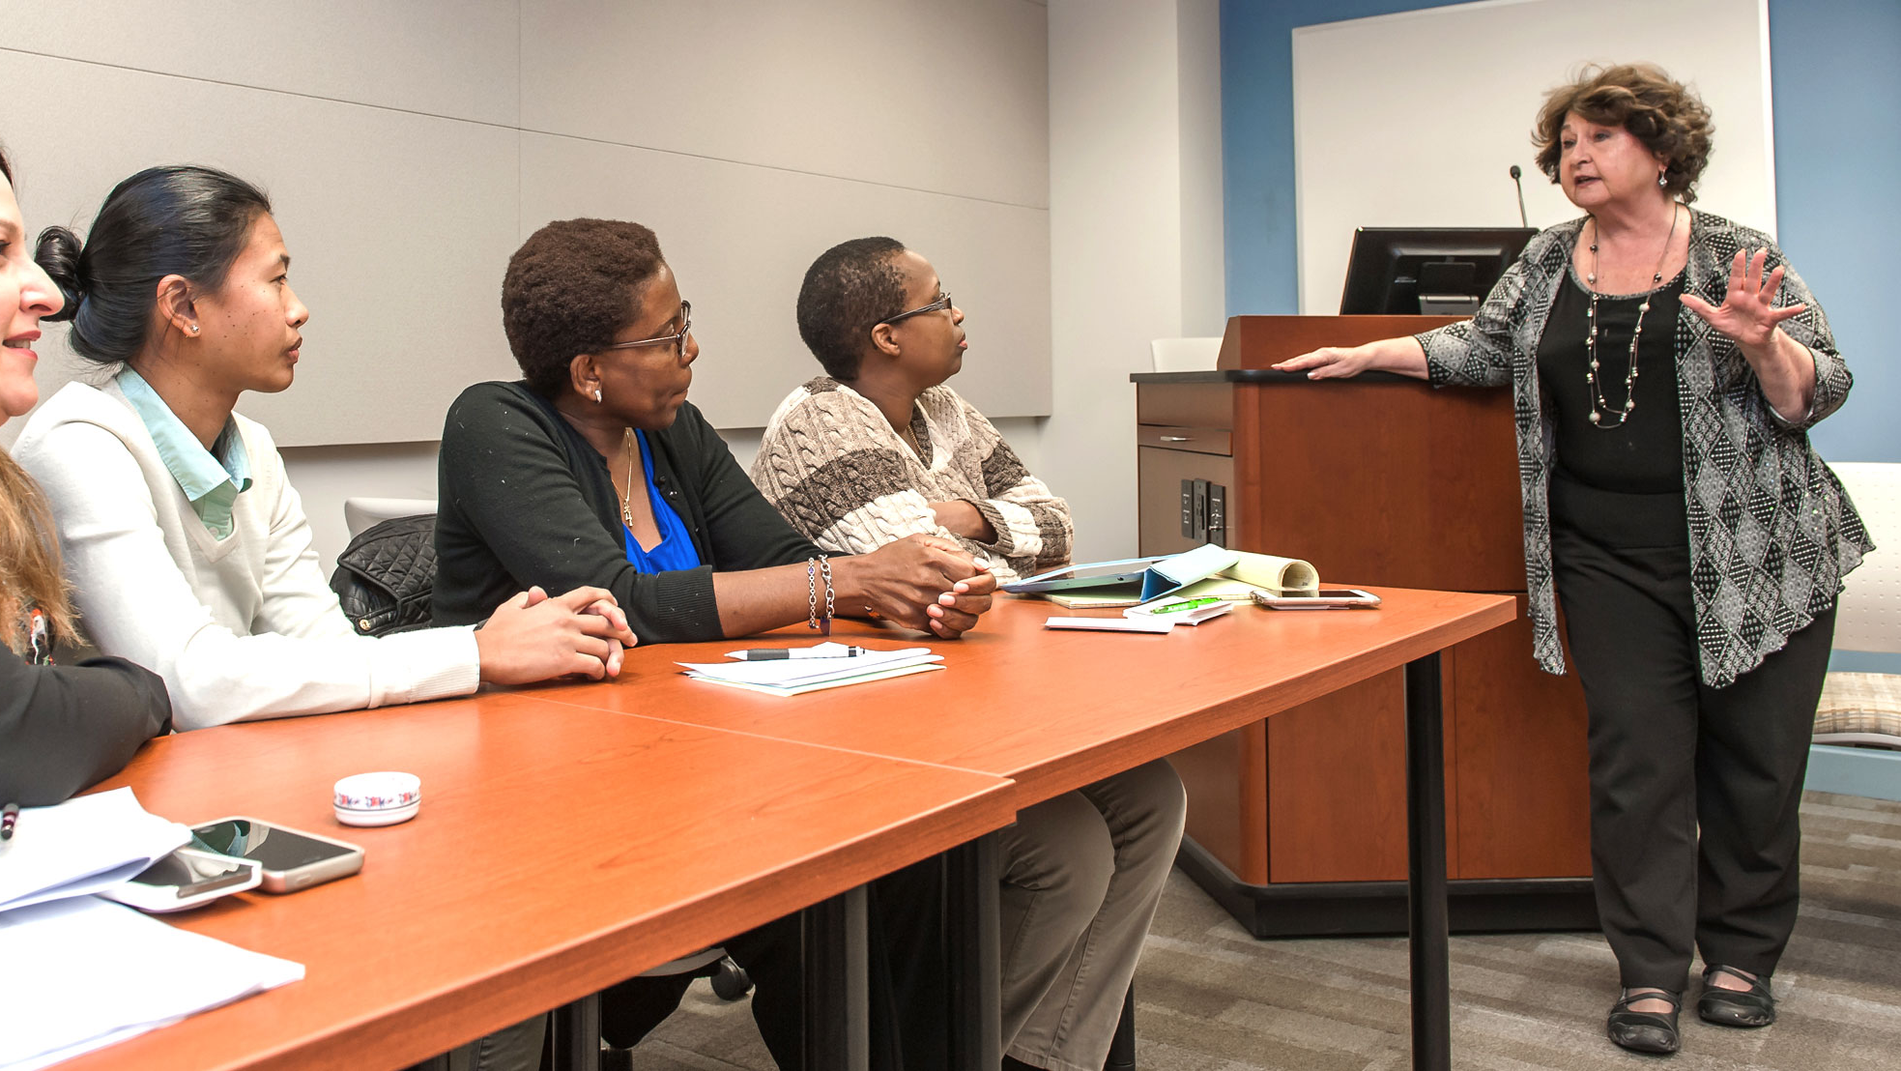
Faculty Resource Guide

Slide 11
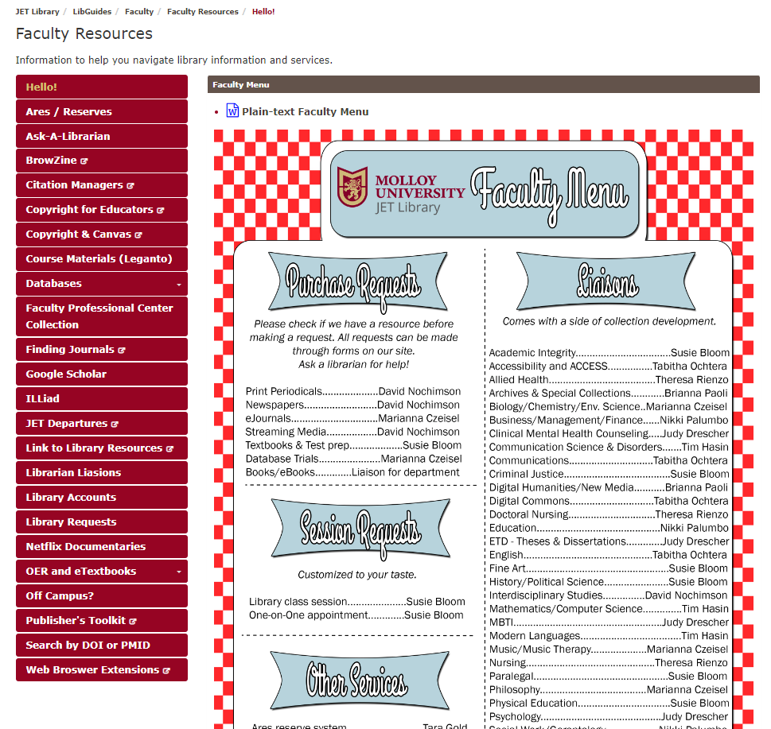

Slide 12
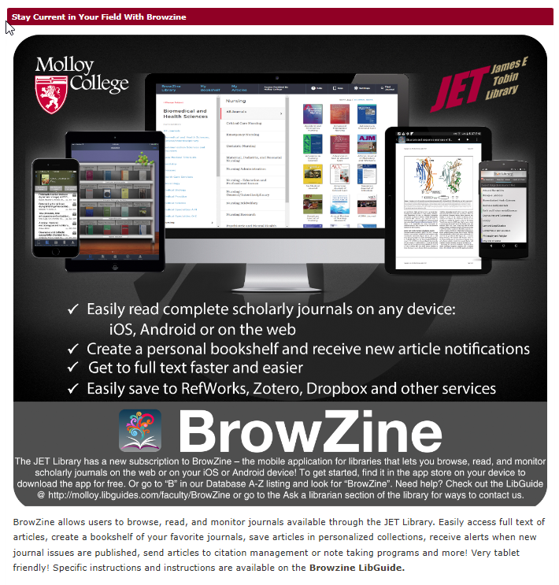

Slide 14
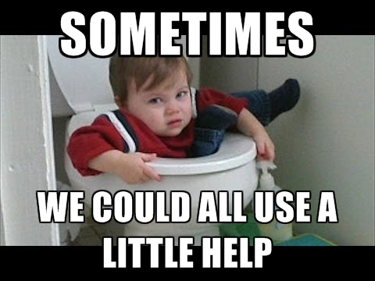
Ways to contact a librarian

Slide 15
