Slide 1


Orientation for New Faculty at Molloy University
Audrey Cohan, Ed.D.
Senior Dean of Research, Scholarship, and Graduate Studies
Contact: acohan@molloy.edu

Slide 2

INTRODUCTIONS,
PLEASE!

Slide 3

Office of Research, Scholarship, and Graduate Studies
Serve as a liaison to faculty and Faculty Professional Center for instructional research needs
Receive recommendations from administration and faculty regarding specific university-wide research needs
(Faculty Handbook, p. 148 for Committee for Faculty Scholarship and Academic Advancement)

Slide 4
Initiate, develop, and oversee professional development activities for faculty which lead to research and scholarship
Coordinate faculty professional development in all aspects of faculty role: curriculum, pedagogy, scholarship, and academic leadership (FPC with Director Maureen Sanz)
Mentorship for individual faculty as needed
Goals:

Slide 5
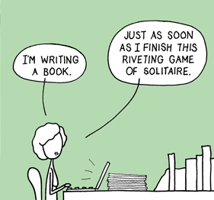
Support Faculty Scholarship

Slide 6

“We are working on building a robust, sustainable, compliant, and faculty-centered research program that is scalable.” -AC

Slide 7
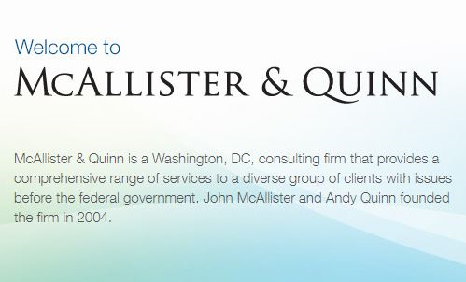
Support From…
Support From…

Slide 8
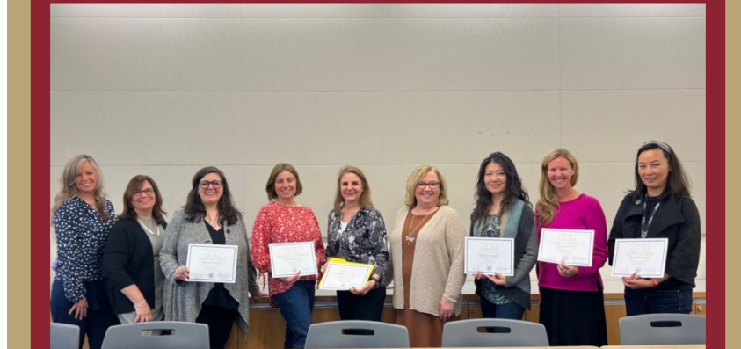
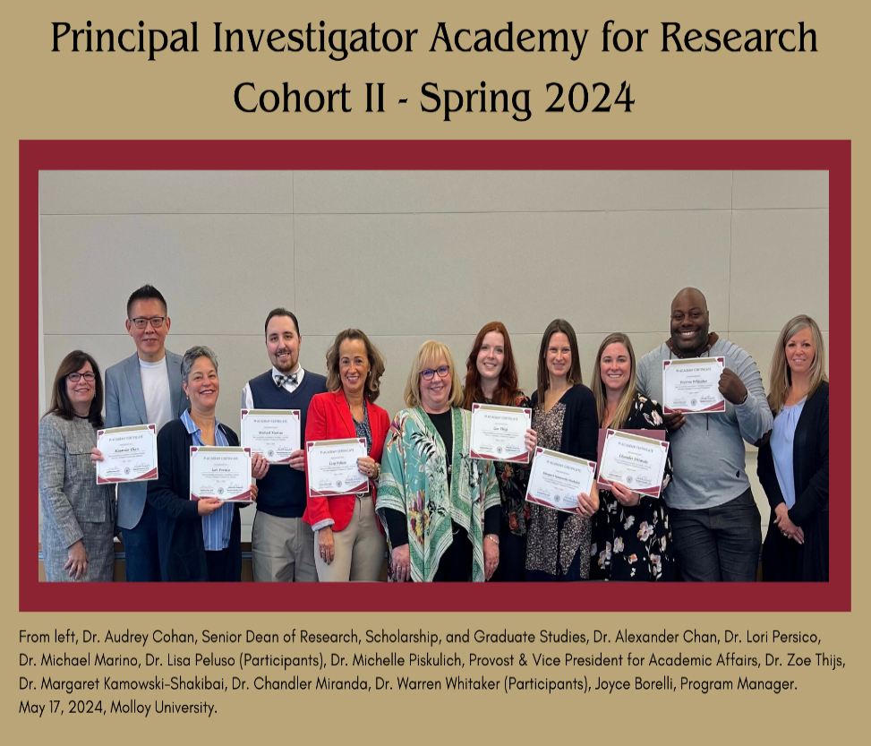
Founding Cohort
PI Academy
In the Spring of 2023, the Office of Research and Scholarship conducted Molloy University's inaugural Principal Investigator Academy for Research in a workshop series with 6 participants.
The inaugural cohort benefited from the Academy and requested an additional 5 sessions held in the Fall of 2023.
In the Spring of 2024, the Office of Research, Scholarship, and Graduate Studies held a second PI Academy with 8 participants.
Cohort II

Slide 9
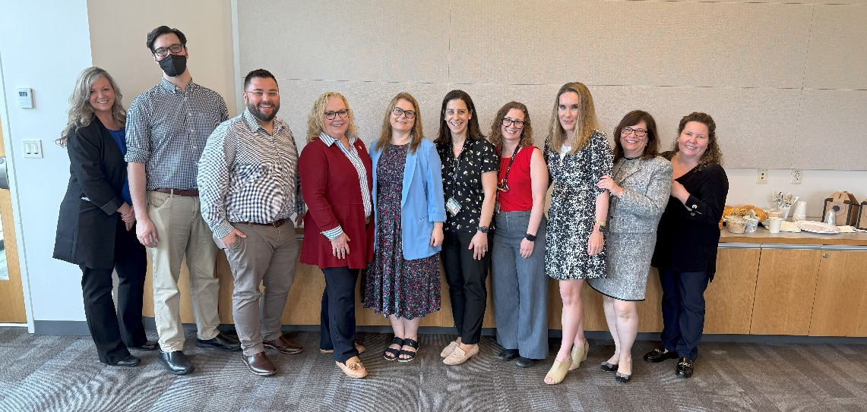
PI Academy
In the Spring of 2025, the Office of Research, Scholarship, and Graduate Studies held a third PI Academy with 7 participants.
Cohort III

Slide 10


Noyce Ambassadors Grant
PI: Audrey Cohan
Co-PIs:
Jodi Evans
John Tanacredi
Deborah Upton
Faculty Associates:
Maureen Sanz
Francine Wisnewski
*Faculty Mentor: Michael Marino
Researcher: Allison Roda
Master Teacher:
Nicki Gonias
*Program Manager: Joyce Borelli

Slide 11

Individual meetings to understand your areas of expertise and projects that you may be interested in pursuing
Self-study of instructional practices
Kellenberg Hall, Room 322

Slide 12

Senior Director of Grants and Sponsored Programs:
Dr. Sherry Radowitz
Associate Director of Grants and Sponsored Programs:
Deborah Waldron
Grants and Research Specialist:
Kristin Maccarrone

Slide 13
Grants Toolkit
https://www.molloy.edu/about/administration/office-of-advancement/office-of-grants/grants-toolkit/

Slide 14
Introduction/Organizational Background
What to include (boilerplate): Grants Office
Establishes who is applying for funds
Institution’s mission and history
University data (e.g., student demographics, faculty-student ratio, retention/graduate rates)
University majors and accreditations
Record of accomplishment
(brief overview)
University rankings
Community initiatives/service-learning and other student activities
Connects logically to problem statement

Slide 15

Funding Sources and Structure
  Funding Sources:
  Government (local, state, and federal)
  Foundations
  Corporations/businesses
  Other nonprofits, hospitals, or school districts that subcontract
  Service clubs
  Private donors
  Funding Structure:
  Grant award
  Subcontract
  Vendor
  Sponsorship
  Contribution

Slide 16

Wonderings?

Slide 17

Questions
and
Answers

