Slide 1

ACADEMIC AFFAIRS
New Faculty Orientation August 2024

Slide 2

HELLO AND WELCOME
Introductions
  Name
  School/Department/Program
  Where you are coming from (last job/school)
  Something you think I should know
A little about me

Slide 3

COMMUNITY
Dedicated to student success
Engaged teacher-scholars
Caring, supportive
Engaged in the community

Slide 4

Academic Affairs Divison

Slide 5
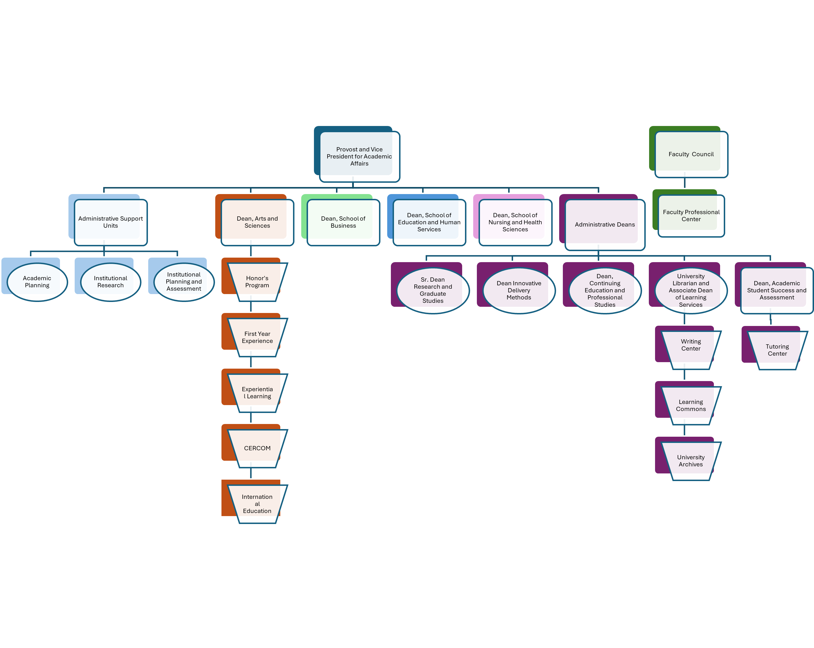
Academic Affairs Organization

Slide 6

MAJOR INITIATIVES
Completing Update of Faculty Handbook
School and University Governance Update
University Promotion and Tenure Standards/Process Completion
School Promotion and Tenure Criteria and Process Completion
Carnegie Community Engagement Designation
New Program Development and Curriculum Redevelopment
Added Focus on Workforce Development
Focus on New Regulatory Standards and Training for Compliance

