Slide 1
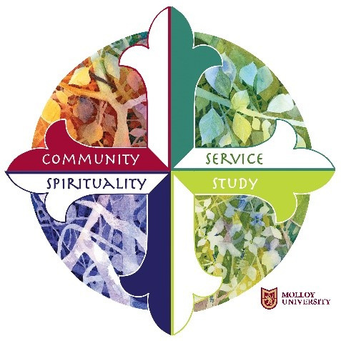
WE WELCOME YOU TO BE A PART OF
MOLLOY'S MISSION
Molloy University an independent, Catholic university, rooted in the Dominican tradition of study, spirituality, service and community, is committed to academic excellence with respect for each person. Through transformative education, Molloy promotes a lifelong search for truth and the development of ethical leadership.
Michelle Martin, Ed.D.
Director of Mission and Ministry
mmartin2@molloy.edu
516-323-3226

Slide 2
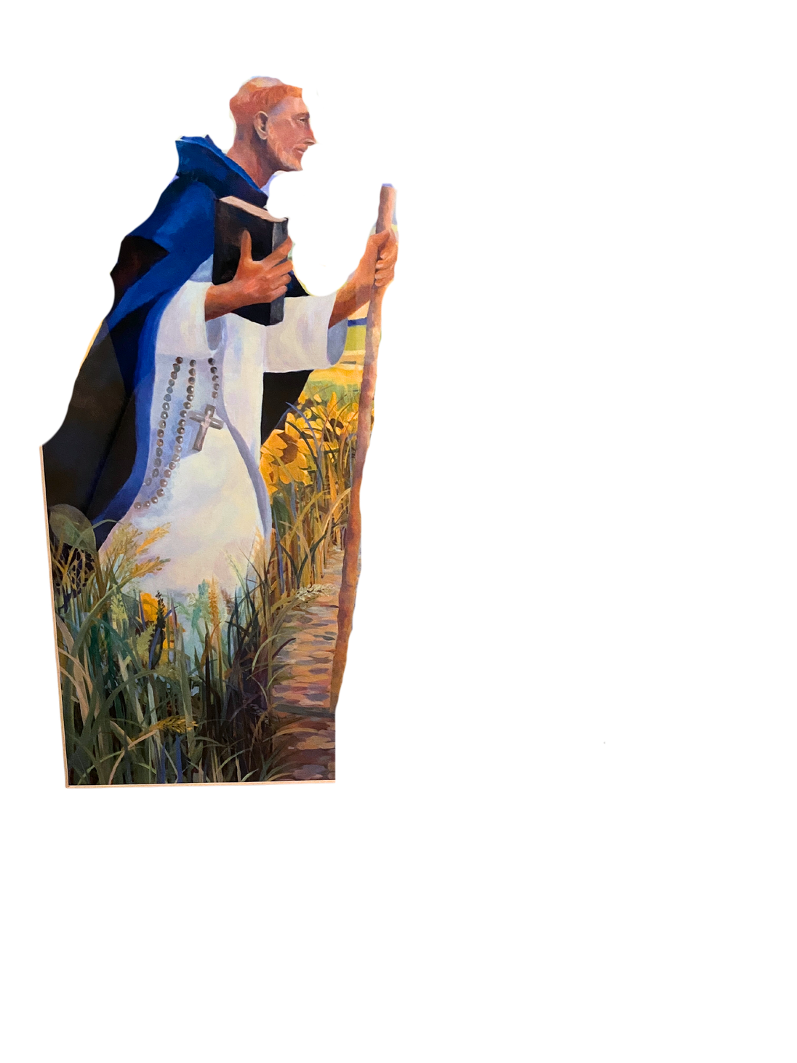
THE DOMINICAN TRADITION
What makes a university Dominican?
  The Order of Preachers (also known as the Dominican Order), founded in the 12th century by St. Dominic, was established to bring a unique gift to the church, indeed to the world. Dominic believed that there were four essential elements to being Dominican, and for us today, to be a university in the Dominican tradition. These elements include:
    An emphasis on the value of study
    An emphasis on the importance of the community
    An emphasis on service to others
    An emphasis on reflection and prayer/having a spiritual practice
  The faculty, staff, and administration at Molloy believe that an emphasis on study, community, service to others, and reflection or spirituality can enrich your life and the lives of those around you. That’s why we have made the Dominican tradition central to the university’s mission.

Slide 3
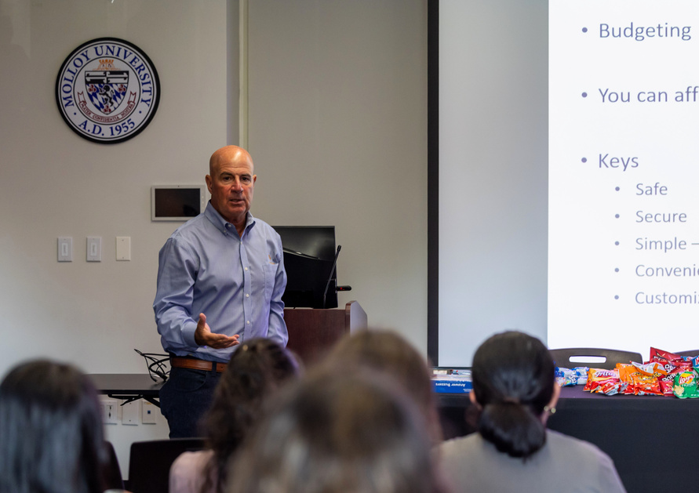
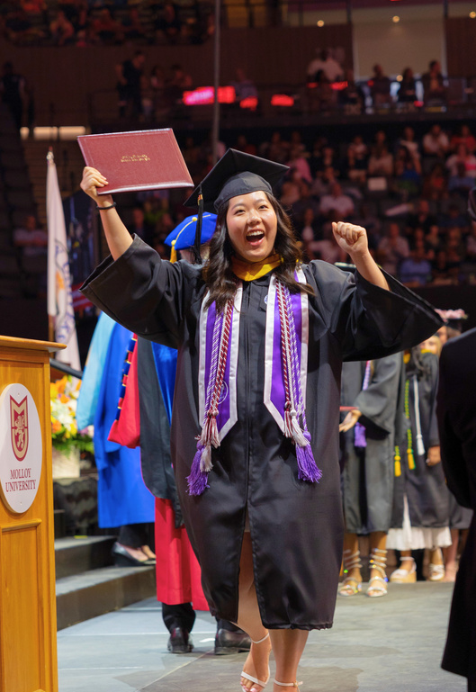
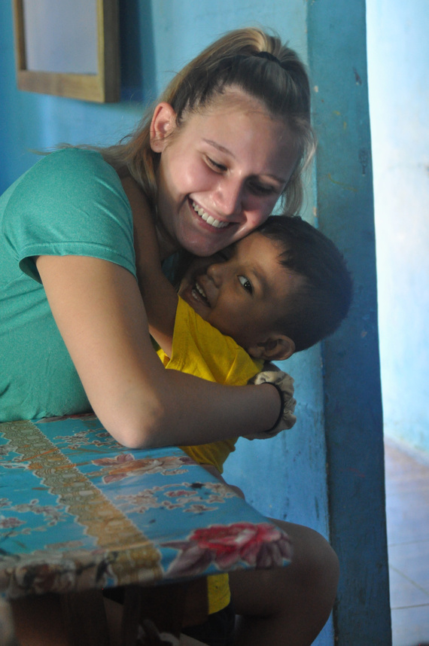
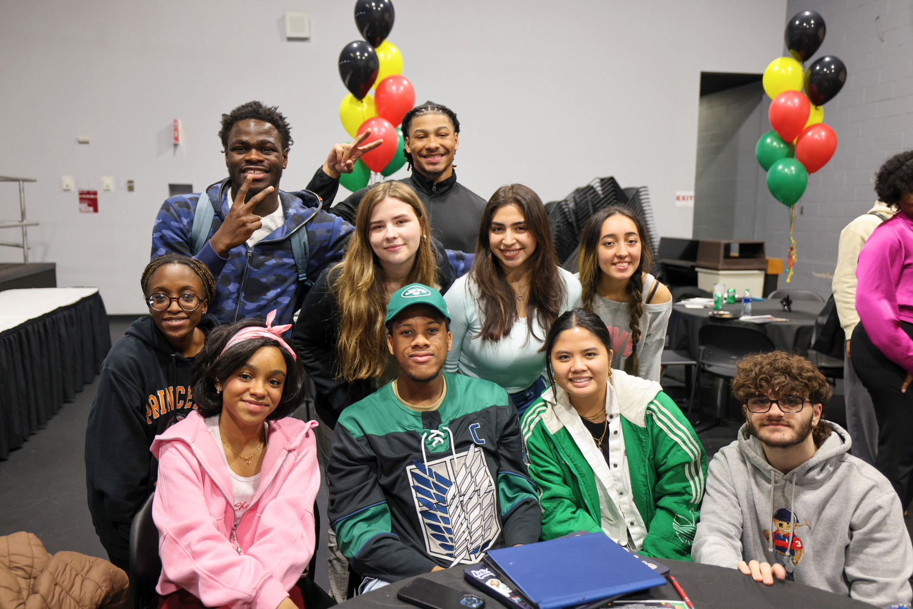
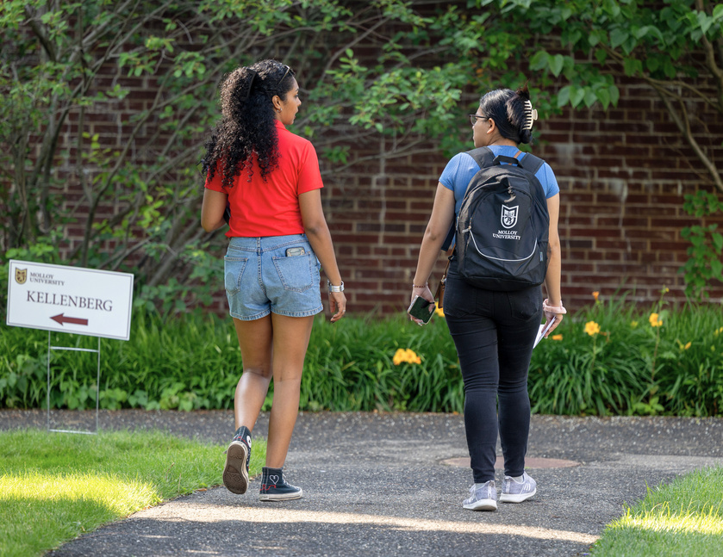
KEY CONCEPTS IN MISSION
1. The Dominican Tradition
2. Search
for Truth
3. Academic Excellence
4. Transformative Education
5. Respect for
Each Person
6. Ethical
Leadership

Slide 4
THE FOUR PILLARS
Community
Service
We need one another. Community challenges us with interdependence and diversity.
The four pillars give us the confidence and direction necessary to give service to the world. Dominicans call that preaching.
Spirituality
Study
Shaped by our own personality and giftedness, meditation and contemplation will take different forms for each person.
St. Dominic said, "Always study!" In the search for truth, we try to listen deeply to the ideas of those with whom we disagree.

Slide 5

MOLLOY’S VALUES AND GUIDING VIRTUES

Slide 6
SACRED SPACES
The following spaces are available on campus for personal reflection:
  Shakespeare Garden
  9/11 Memorial Garden
  Our Lady of the Lourdes Grotto
  Sister/Student Sculpture
  Sacred Heart Chapel and Meditation Center
  Healing Garden
  Cloister Garden
  Muslim Prayer Room

