Slide 1

Belonging and Thriving
@ Molloy University
Donald “DJ” Mitchell, Jr., Ph.D.
Vice President for Mission Integration

Slide 2
Our Mission
Molloy University, an independent, Catholic university rooted in the Dominican tradition of study, spirituality, service and community, is committed to academic excellence with respect for each person. Through transformative education, Molloy promotes a lifelong search for truth and the development of ethical leadership.
Notes:
So when you look at enrollment, retention rates and graduation rates by various identities and intersecting identities, we see gaps. So those from higher incomes graduate at higher rates, we see gaps across races/ethnicities, by if a student’s parent graduated from college, by sex and gender, by sexual orientation, nationality, ability, and the list goes on. But at Molloy, we value diversity, equity and inclusion because we don’t want to see these gaps and when we do see gaps, we want to close them. Informed by our mission and by the vision of our founders, the Sisters of St. Dominic of Amityville, we want to see all students succeed so valuing diversity, equity and inclusion is part of the fabric of Molloy, and we want you to know that as you join our community.
So what is DEI? We hear it a lot but let’s make sure we are on the same page.

Slide 3
Values that Guide the Office of Mission Integration
Molloy University welcomes everyone.
Molloy University gives people what they need, even when it is not the same thing.
Molloy University wants everyone to belong and thrive.
Notes:
Someone define diversity.
My definition of diversity is simply difference. Diversity highlights our differences.
What about equity?
And finally inclusion?
Who wants to belong and thrive? Everybody is here to get a degree and leave here successful, so we should all work to make sure we all belong and thrive no matter how different we are. We should want everyone to be able to do just as well as us, because we all want to belong and thrive.
When a university community values DEI, we ensure everyone belongs and thrives. So that’s why I lead our DEI initiatives across campus, because this is our north star. The success of everyone within our community.

Slide 4
Some Belonging and Thriving Teaching Strategies
Start with the syllabus!
Think about representation when choosing texts and materials
Introduce your gender pronouns and use preferred names
Don’t single out students to speak on behalf of a population
Work closely with the Center for Access and Disability (ACCESS)
Keep up with university-wide MI policies (e.g., Title IX, Non-discrimination, Harassment)

Slide 5
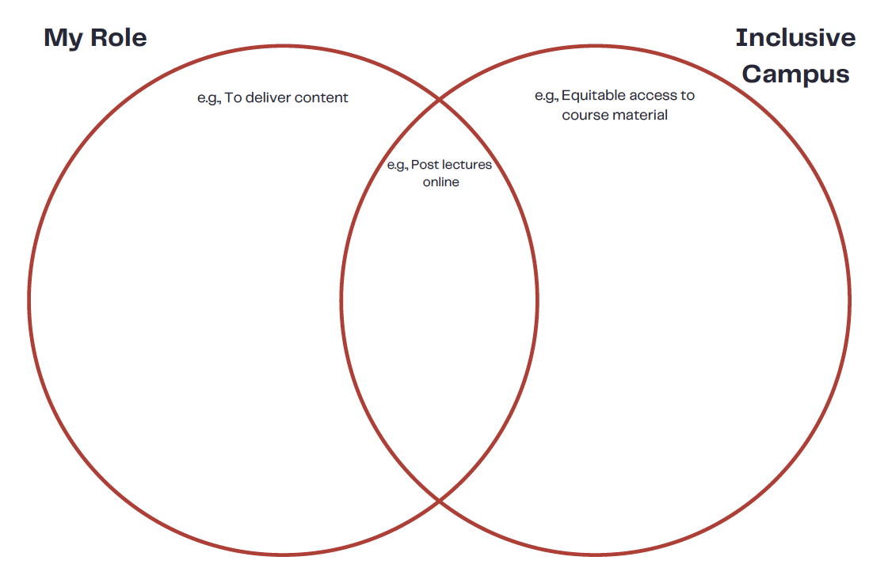
Marie, 2022

Slide 6
Faculty Resources and MI Initiatives
University-wide Mission Integration (MI) Committee
Employee Affinity Groups
Strategic Plan/Priority I
MI Grants
Campus Climate Survey
MI Faculty Fellows Program (full-time, tenured faculty)
Training and Development w/ HR
Faculty Diversity Plan w/ Academic Affairs (NYS requirement)
One-on-one meetings regarding teaching strategies and brainstorming
Requests for classroom visits on various topics

Slide 7
Contact Info
Email: dmitchell1@molloy.edu
Phone: x4060
Office: Kellenberg 114A
Q&A

