Slide 1
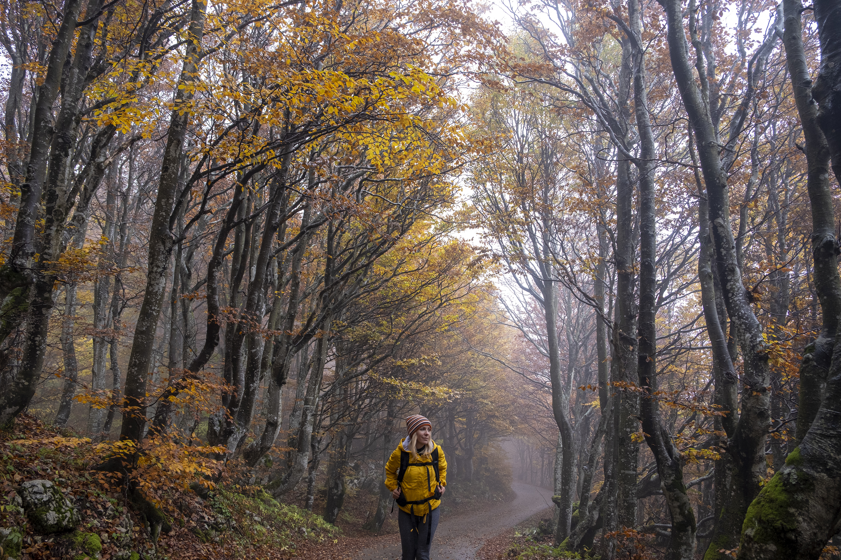
Governance
New Faculty Orientation
Molloy University
August 28, 2024
Dr. Debra R. Hanna, PhD, RN
Faculty President (2024-26)

Slide 2
A few words about St. Dominic
St. Dominic was born in 1170 in Spain
St. Dominic eventually went to France as a missionary priest and engaged in dialog with Cathars.
After 10 years of active dialog, a group of 9 female Cathars asked to convert and to form a community of sisters. This group became the first Sisters of St. Dominic.
Their convent is at Prouhile, in Fanjeaux, France.
About 10 years later St. Dominic founded the Order of Preachers (OP), a religious order for men to become priests and brothers.
St Dominic died in 1221.
Notes:
He was educated at the University of Palencia (first university in Spain, founded with the University of Salamanca).

Slide 3
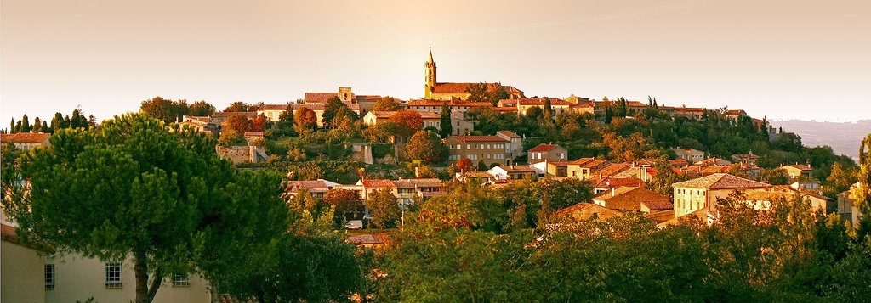
Fanjeaux, France
Notes:
This is a photo of the town of Fanjeaux, France which is where the first nine who met St. Dominic, were baptized, evangelized, and consecrated as the Sisters of St. Dominic.

Slide 4
Dominican ideas
St. Dominic strongly believed in dialog, being open to all points of view, seeking truth, and studying well to be able to engage in dialog and discern truth.
He believed in a democratic form of self-governance
Dominican community strongly emphasize dialog, study, community, service to others and mission.
This is the foundation of Molloy’s Four Pillars: Study, Community, Service, and Spirituality

Slide 5
Governance at Molloy University
Our governance document is currently being reviewed and revised
The document was last approved in 2012.
Since that time Molloy has grown from a college to a university, and the structure of our institution has changed.
Currently, we have 4 schools, which will have school-level self-governance that will mesh with university-level governance.
When the new school year begins, as Faculty President, I will serve on the governance committee

Slide 6
University Governance Process
Our governance document guides the process for institutional decision-making at the college/university level.
The governance committee will engage in dialog with various committees and representatives from the schools to create a way for schools to self-govern that will be compatible with overall university-level governance.

Slide 7
Faculty Council
Faculty council has 8 elected faculty members, 2 from each school
I was elected the faculty president for 2024-2026
The council meets weekly during the academic year except on college holidays. Faculty can bring their concerns to the council 1 Monday a month
When faculty decisions are needed, the issue is brought to the whole faculty for discussion at Teaching Faculty meetings.
After faculty dialog ends, a vote is taken by the whole faculty.

Slide 8
Faculty Handbook
The Faculty Handbook contains important information about faculty duties, committees, benefits, and due process.
New faculty are encouraged to read the faculty handbook, to become familiar with their faculty duties and the expectations for classroom management, student advisement, annual review, and more.
The Faculty Handbook contains specific guidance so new faculty will be able to achieve promotions and tenure.
The Handbook is online at the Faculty Council page.

Slide 9
Faculty Due Process
The Faculty Handbook gives specific information about the steps to take if faculty believe they have been treated in an unjust way
Examples: Adverse decision for promotion or tenure, or if there is an accusation of inappropriate faculty behavior
Faculty are expected to comply with federal laws that related to student privacy, and freedom from harassment or unjust treatment. If faculty are accused, faculty have a right to defend themselves.

Slide 10
Six Standing Governance Committees
Priorities and Planning Committee [meets after Colloquium]
Financial Resources Committee
Undergraduate Policies and Programs
Graduate Policies and Programs
Student Life Committee
Community and Campus Life Committee
Recommendations made by standing committees must be approved by the university president and Board of Trustees

Slide 11
Faculty Committees – University wide
Faculty Council
Promotion & Tenure committee
Sabbatical Committee
Faculty Scholarship & Academic Advancement Committee
Nominations & Elections committee
Contract committee
Faculty Professional Center committee

Slide 12
Molloy University Colloquium
All members of Molloy Community are invited to discuss any decisions for the entire community
Once the discussion is held, Priorities and Planning meets immediately after to approve or reject any proposals/decisions.

Slide 13
Faculty Responsibilities
Classroom: Syllabus; Class set-up with sufficient contact time; Testing; Grading; Incompletes; Non-attending report; Academic infractions; Attendance; Letters for Tuition Reimbursement; Letters of Recommendations
Cancellation of Classes (Snow/Weather); Faculty Absence
Evaluation of tenured and non-tenured faculty
Workload data sheet
Annual Review (form & process)
Student evaluation of faculty
Colleague evaluation of faculty
Textbook selection (usually 6 months in advance)
Student advisement
Weekly office hours

Slide 14
Expectations for Faculty Development
Attendance at disciplinary conferences
  Submit a faculty conference request form with costs to your dean to receive approval. Must be approved at the school level before attending. After attending the conference must submit again with actual receipts to be reimbursed.
Keep up with journal reading for your discipline
Be an active member of disciplinary professional associations
Produce scholarship (peer-reviewed articles, book chapters, books, conference presentations based on research.
Engage in service (students, faculty, college, community at large)
Achieve teaching excellence

Slide 15
Faculty President 2024-2026
Debra Hanna, SONHS
Email: dhanna@molloy.edu
Office phone: 1-516-323-3689
Office is in Hagan Room 312
Usually on campus on Mondays (12:15p-1:50p = Faculty council meetings: 2:30p-4:30p = in-person/online office hours)
I will meet via Zoom by mutually agreed appointment as needed, however, each school has 2 faculty councilors

Slide 16
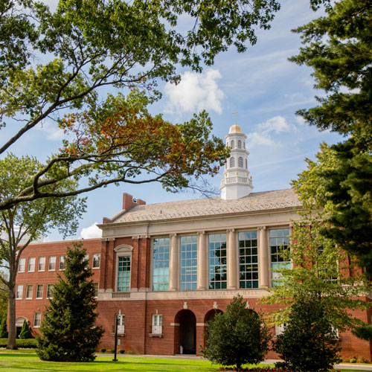
WELCOME TO MOLLOY

