Slide 1
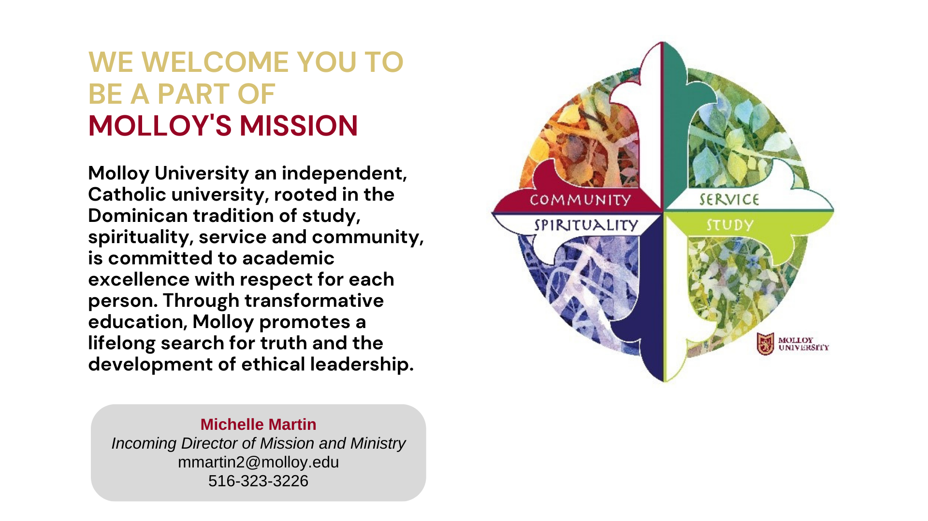

Slide 2
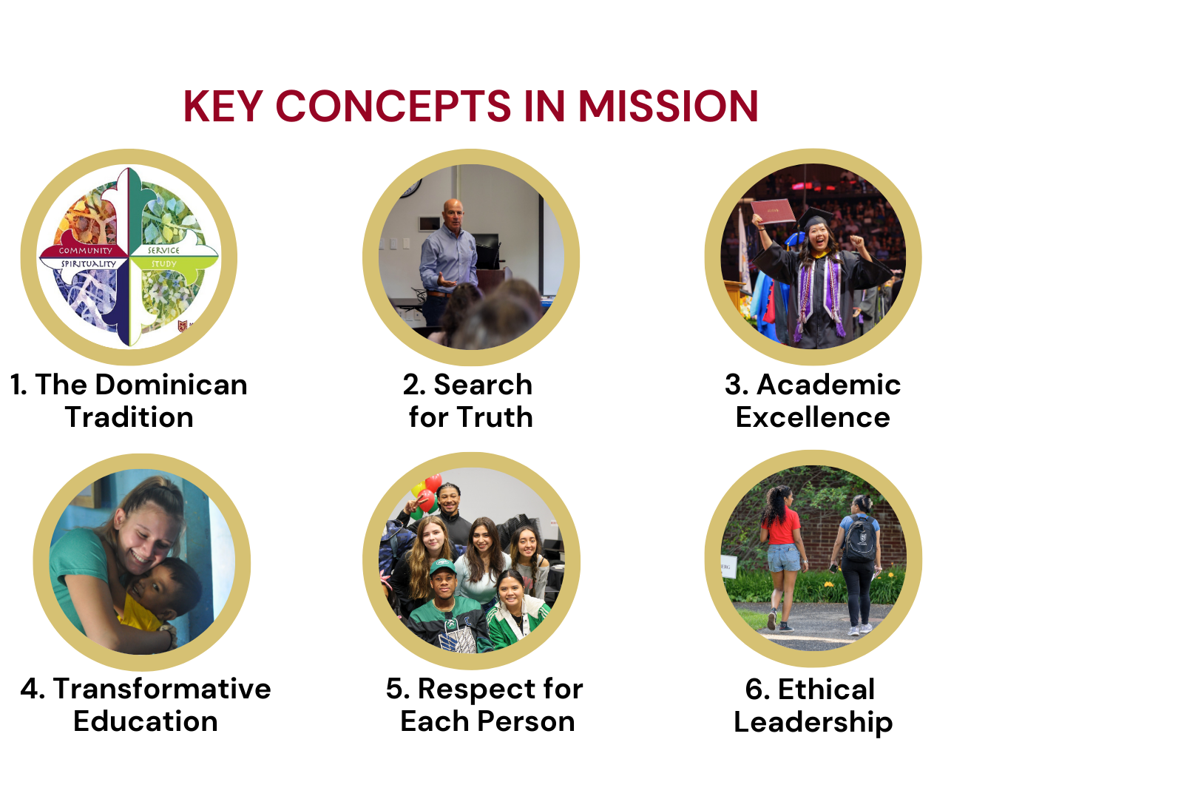

Slide 3


Slide 4
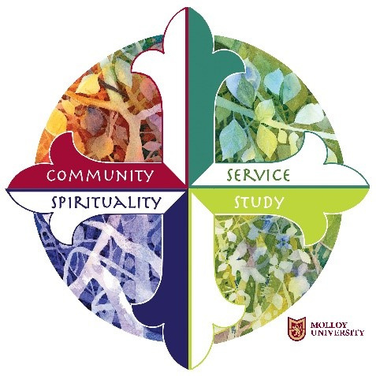
MISSION EXPERIENCES
SACRED SPACES
Molloy provides a number of immersion experiences in the Dominican Tradition, such as those listed below. Also, there are regularly scheduled campus-wide lectures, “lunch and learn” opportunities, and service projects that provide experiences of “living the mission.”
  Mission Ambassador Program
  Service Activities
  Sisters of St. Dominic Motherhouse in Amityville
  Dominican Fanjeaux Pilgrimage
The following spaces are available on campus for personal reflection:
  Shakespeare Garden
  9/11 Memorial Garden
  Our Lady of the Lourdes Grotto
  Sister/Student Sculpture
  Sacred Heart Chapel and Meditation Center
  Healing Garden
  Cloister Garden
  Muslim Prayer Room
Questions?
Michelle Martin
Incoming Director of Mission and Ministry
mmartin2@molloy.edu
516-323-3226
Public Square 390

