Slide 1
Diversity, Equity and Inclusion (DEI)
@ Molloy University
Donald “DJ” Mitchell, Jr., Ph.D.
Vice President for Diversity, Equity and Inclusion
**Incoming Vice President for Mission Integration & Inclusion**

Slide 2
What is DEI?
Diversity is the presence of differences that may include race, gender, religion, sexual orientation, ethnicity, nationality, socioeconomic status, language, (dis)ability, age, religious commitment, or political perspective. Diversity = Difference
Equity is promoting justice, impartiality and fairness within the procedures, processes, and distribution of resources by institutions or systems. Giving people what they need, not giving people the same thing.
Inclusion is an outcome to ensure those that are diverse actually feel and/or are welcomed. Making sure we all belong and thrive.
DEI = Belonging and Thriving
eXtension Foundation Impact Collaborative, n.d.

Slide 3
Some Inclusive and Equitable Teaching Strategies
Start with the syllabus!
Think about representation when choosing texts and materials
Introduce your gender pronouns and use preferred names
Don’t single out students to speak on behalf of a population
Work closely with the Center for Access and Disability (ACCESS)
Keep up with university-wide DEI policies (e.g., Title IX, Non-discrimination, Harassment)

Slide 4
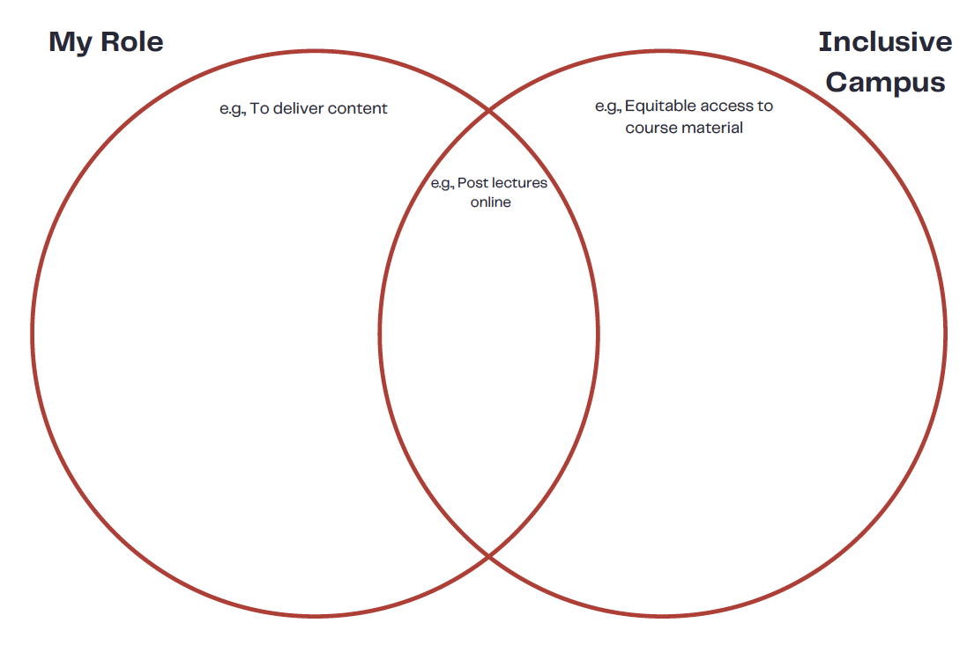
Marie, 2022

Slide 5
Faculty Resources and DEI Initiatives
University-wide DEI Committee
Employee Affinity Groups
DEI Strategic Plan/Priority
DEI Grants
Campus Climate Survey
DEI Faculty Fellows Program (full-time, tenured faculty)
Training and Development w/ HR
Faculty Diversity Plan w/ Academic Affairs
One-on-one meetings regarding inclusive teaching strategies and brainstorming
Requests for classroom visits on various DEI topics

Slide 6
Contact Info
Email: dmitchell1@molloy.edu
Phone: x4060
Office: Kellenberg 114A
Q&A

