Slide 1

NYS Mental Health Counseling Licensure Application Process
The CMHC Program at Molloy University

Slide 2

Agenda
NYS OP Website
Applicant Checklist
Steps 1-3
Diagnostic Privilege
The NCMHCE
Documenting your hours
Helpful Tips

Slide 3


Starting Point
The NYS Office of Professions Website:
https://www.op.nysed.gov/professions/mental-health-counselors/license-requirements
https://www.op.nysed.gov/professions/mental-health-counselors/application-forms

Slide 4
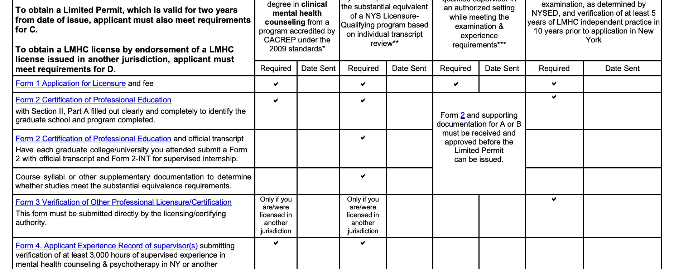
Applicant Checklist
https://www.op.nysed.gov/sites/op/files/prof/mhp/lmhcchecklist.pdf

Slide 5
The Process
1- Start the Application – Form 1
2- Verification of degree – Form 2
Completed online
Can be started prior to graduation
Cost $371
Will need to include the child abuse (mandated reporter) training certificate that you have completed
Complete top portion of the form
Give form to Danielle prior to May 1
Registrar will be able to complete the form after May 9th
Registrar sends directly to state
https://www.op.nysed.gov/sites/op/files/prof/mhp/mhc2.pdf

Slide 6
3- Getting the Limited Permit
Form 5 and 5CS
Completed once employment and a qualified supervisor is obtained
Form 5
Can be completed once the state has verified Form 1 and Form 2 have been received
Cost: $70
Form 5CS
Section I: Complete this section. Give your supervisor a copy of Appendix A and have them complete Section II.
  Appendix A is a reference for you to know what your supervisor needs offer to you as your supervisor
  This is helpful in your job search so that you can ensure that your supervision and hours will count
Section II: Your supervisor must complete this section before you can submit it to the Office of the Professions at the appropriate address at the end of the form. It is your responsibility to ensure your supervisor fully completes Section II. Failure to complete this form will delay its review.

Slide 7
Diagnostic Privilege
To satisfy the requirement of licensure and the diagnostic privilege you will need to obtain 3,000 hours of supervised experience of which 2,000 hours must be direct client contact in activities that include but is not limited to diagnosis, psychotherapy and assessment-based treatment planning.
Your supervisor must have the authority to diagnose
There are two applications: One for Licensure and One for privilege. There may be some redundancies in the application process.
An applicant can submit the applications for both licensure and privilege at the same time. However, NYSED will evaluate the application for licensure 1st. Once they have determined that you meet the requirements for licensure and grant the license – they will then review the application for the privilege.
The application (Form 1D) is also found at https://www.op.nysed.gov/professions/mental-health-counselors/application-forms and costs $175
Follow the instructions for application on the website above

Slide 8
The NCMHCE
Registration Process
Resources
After NYS reviews and approves Form 1 and 2:
  You will receive notification of approval of your education and all application materials from the New York State Education Department
  The state notifies you and the examination administrators when you have satisfied the examination eligibility requirements
  You will register directly with the examination administrator to take the examination after being notified of your eligibility
https://nbcc.org/exams/ncmhce
https://counselingexam.com/
https://nymhca.org/page/institute-examprep
https://www.mometrix.com/academy/ncmhce-study-guide/

Slide 9
Documenting Your Hours
Forms 4 and 4B
Form 4
Form 4B
Purpose: This is your record of clinical experience
Complete this as you complete your 3,000 hours, especially if you change sites
This helps you keep an overall log of your hours
Note – If you only have 1 site, you will only need to complete this one time before you send it to the state
This is your supervisor's attestation of your hours – it is given to them to sign and send to the staste
Make sure that you have all lines on Form 4 completed for each site/supervisor
There is a spot on Form 4 where you will indicate the corresponding number on the 4B form
4B’s can be sent in early if you change sites and they will be kept in your file with the state, however form 4 would need to be sent in once your 3,000 hours are completed

Slide 10
Helpful Tips
Keep copies of everything!
Store all of your papers in one secure place
This is at least a 20 month process, so you don’t want to be scrambling to find paperwork when you need it
Be sure to track your working hours as you go so that you stay on top of you progress
Only the total hours will need to be submitted to the state; you will need to attest that 2,000 of the hours were direct clinical work
Only working hours count – not vacation time or holidays
There is no set way to track them so find a way that works for you

